Slide 1
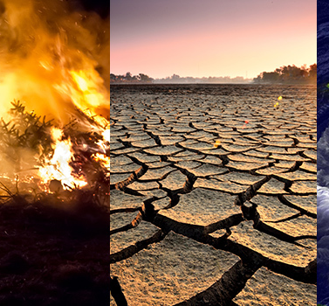
Whats already changed in our country?
Sweden= the temperature has increased, and we don’t get as much snow now.
Italy= temperature is getting hotter, in the summer the temperature is higher than normal and in the winter it isn’t as cold as usual .
Germany=It has become harder to grow food for farmers in Germany.

Slide 2
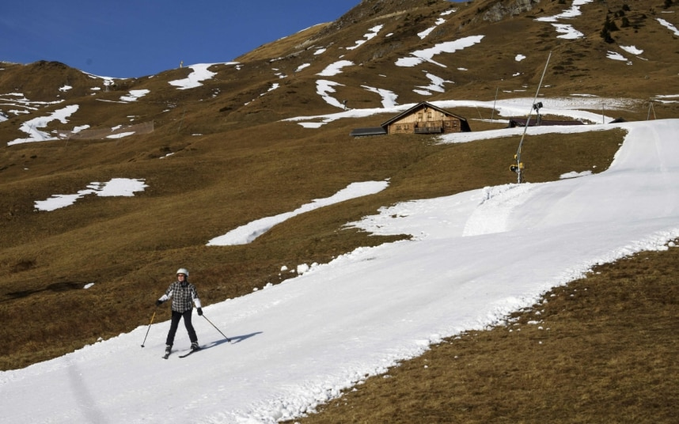
What effects does the climate changes have to the life in your country
Christmases without snow
We will have a bigger chance to get cancer if the Ozon layer gets thinner.
More frequent high temperature extremes, such as hot days and nights and heat waves, will affect human health. This could lead to an increase in the cases of temperature related mortality, as already experienced in recent heat events. Especially vulnerable sectors of the population, such as the elderly and infants, will be affected the most.
economically speaking, it would have a serious impact on tourism, especially in the winter, because people like to skiing, but if the snow melts they wouldn't go skiing and the ski resorts would shut down

